Slide 1
Variance

Slide 2
Topics
Variance and standard deviation
Transforming random variables
Combining random variables

Slide 3
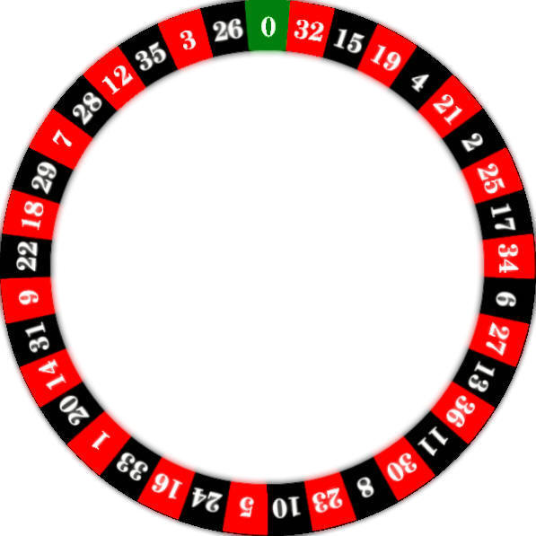
Three options:
Bet on black
Bet on red
Bet on green
18 Black Spaces
18 Red Spaces
1 Green Space

Slide 4
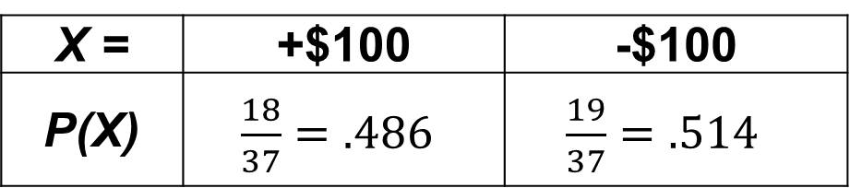

Variance of Random Variables
Let X = winnings from a $100 bet on black
X = | +$100 | -$100
P(X) | $\frac{18}{37}=.486$ | $\frac{19}{37}=.514$
18 Black Spaces
18 Red Spaces
1 Green Space
$$E\left(X\right)= μ_{X}=−2.80$$

Slide 5
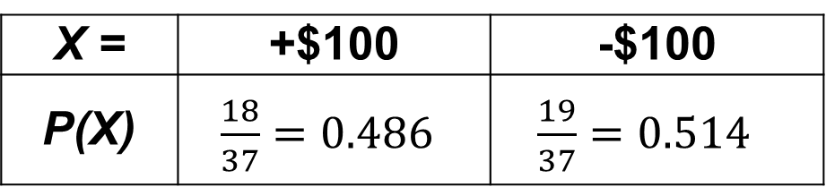
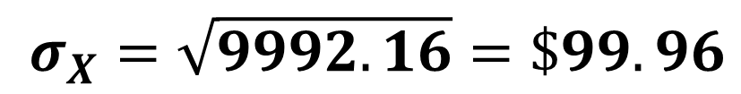
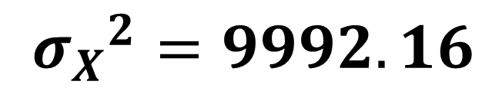
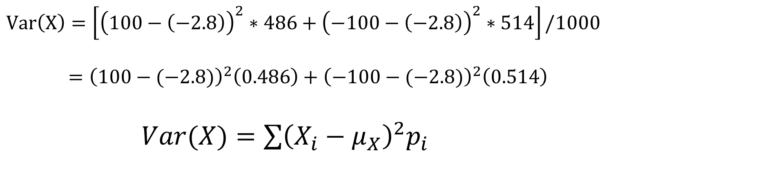
Variance of Random Variables
Let X = winnings from a $100 bet on black
18 Black Spaces
18 Red Spaces
1 Green Space
X = | +$100 | -$100
P(X) | $\frac{18}{37}=0.486$ | $\frac{19}{37}=0.514$
$$Var\left(X\right)=\left[{\left(100−\left(−2.8\right)\right)}^{2}∗486+{\left(−100−\left(−2.8\right)\right)}^{2}∗514\right]/1000$$
$={\left(100−(−2.8)\right)}^{2}\left(0.486\right)+{\left(−100−(−2.8)\right)}^{2}\left(0.514\right)$
$Var(X)=\sum{{\left(X_{i}−μ_{X}\right)}^{2}p_{i}}$
$${σ_{X}}^{2}=9992.16$$
$$σ_{X}=\sqrt{9992.16}=\$99.96$$

Slide 7
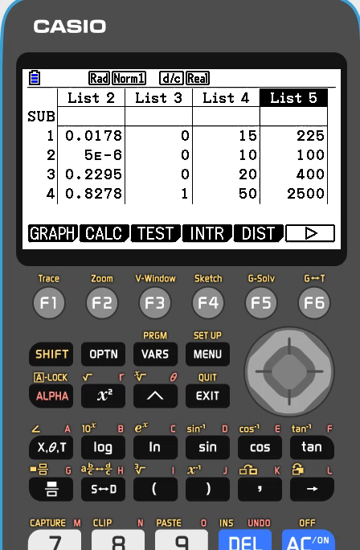

Slide 8
Topics
Variance and standard deviation
Transforming random variables
Combining random variables

Slide 9
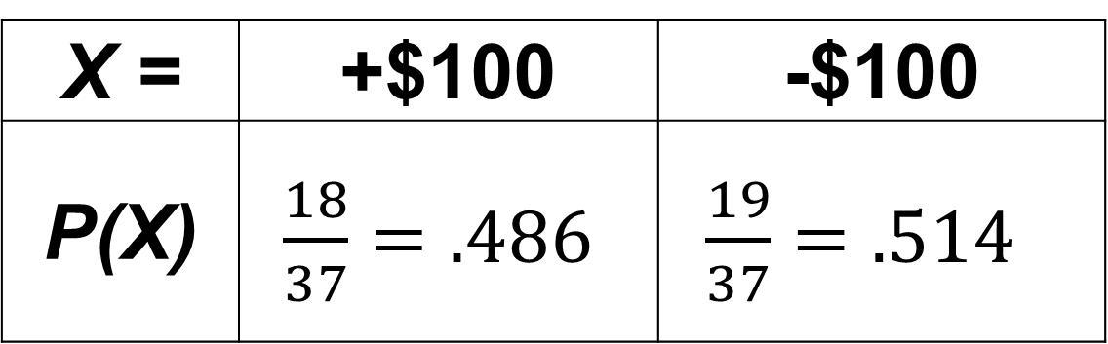

Transforming Roulette
Let X = winnings from a $100 bet on black
X = | +$100 | -$100
P(X) | $\frac{18}{37}=.486$ | $\frac{19}{37}=.514$
18 Black Spaces
18 Red Spaces
1 Green Space
$$E\left(X\right)= μ_{X}=−\$2.80$$

Slide 10
Imagine you have to pay a $5 fee to play.
Transformed random variable:
X - 5

Slide 11
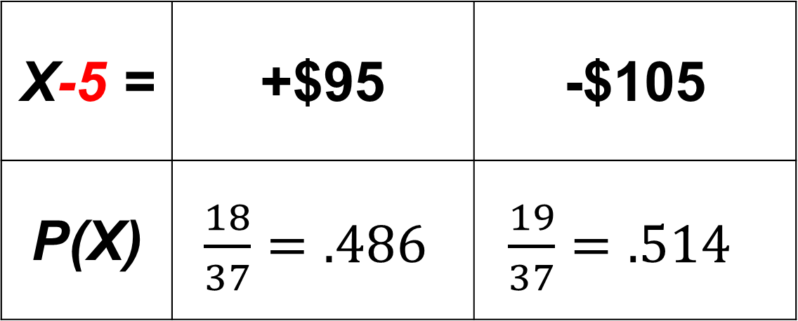
Transforming Roulette
Let X - 5 = winnings from a $100 bet on black, with $5 fee to play.
X-5 = | +$95 | -$105
P(X) | $\frac{18}{37}=.486$ | $\frac{19}{37}=.514$
18 Black Spaces
18 Red Spaces
1 Green Space

Slide 12
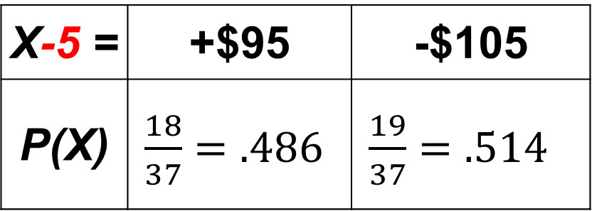
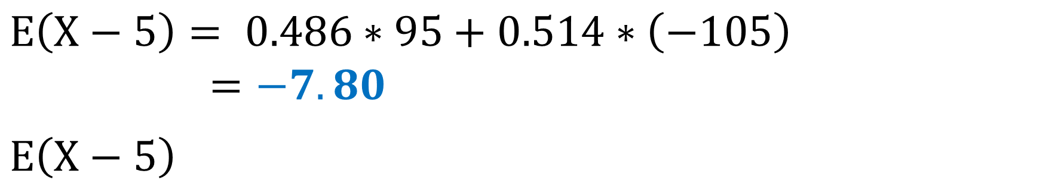
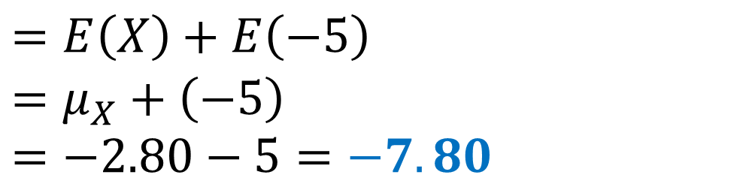
Transforming Roulette
X-5 = | +$95 | -$105
P(X) | $\frac{18}{37}=.486$ | $\frac{19}{37}=.514$
a) Find the expected value of playing this game.
$$E\left(X−5\right)= 0.486∗95+0.514∗\left(−105\right)$$
$=−7.80$
$$E\left(X−5\right)$$
$$=E\left(X\right)+E\left(−5\right)$$
$$=μ_{X}+\left(−5\right)$$
$$=−2.80−5=−7.80$$
“Linearity of Expectation”

Slide 13
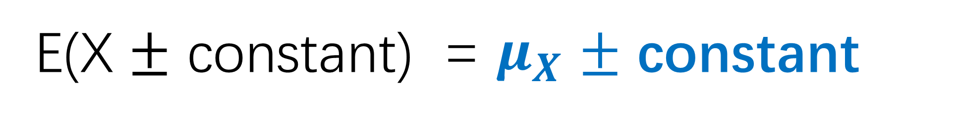
Transforming Roulette
E(X $±$ constant) = $μ_{X}$ $±$ constant

Slide 14
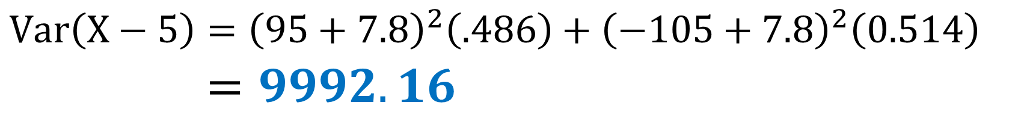
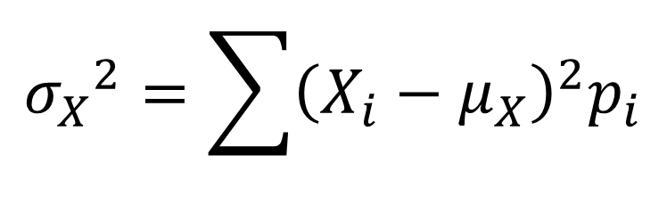

Transforming Roulette
b) Find the variance and standard deviation for this game.
X-5 = | +$95 | -$105
P(X) | $\frac{18}{37}=.486$ | $\frac{19}{37}=.514$
$$Var\left(X−5\right)={\left(95+7.8\right)}^{2}\left(.486\right)+{\left(−105+7.8\right)}^{2}\left(0.514\right)$$
$$=9992.16$$
$${σ_{X}}^{2}=\sum{{\left(X_{i}−μ_{X}\right)}^{2}p_{i}}$$
$$Var\left(X\right)=9992.16$$
Adding/subtracting all outcomes by a constant doesn’t change the variation between outcomes!

Slide 15
When adding or subtracting
random variables by a constant…
Center:
adds/subtracts by that constant amount.
2. Spread:
remains the same.

Slide 16
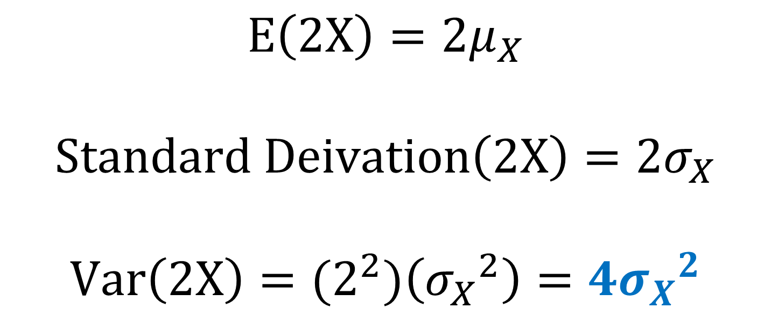
Multiplying a random variable by a constant
$$E\left(2X\right)=2μ_{X}$$
$$Standard Deivation\left(2X\right)=2σ_{X}$$
$$Var\left(2X\right)={(2}^{2})\left({σ_{X}}^{2}\right)=4{σ_{X}}^{2}$$

Slide 17
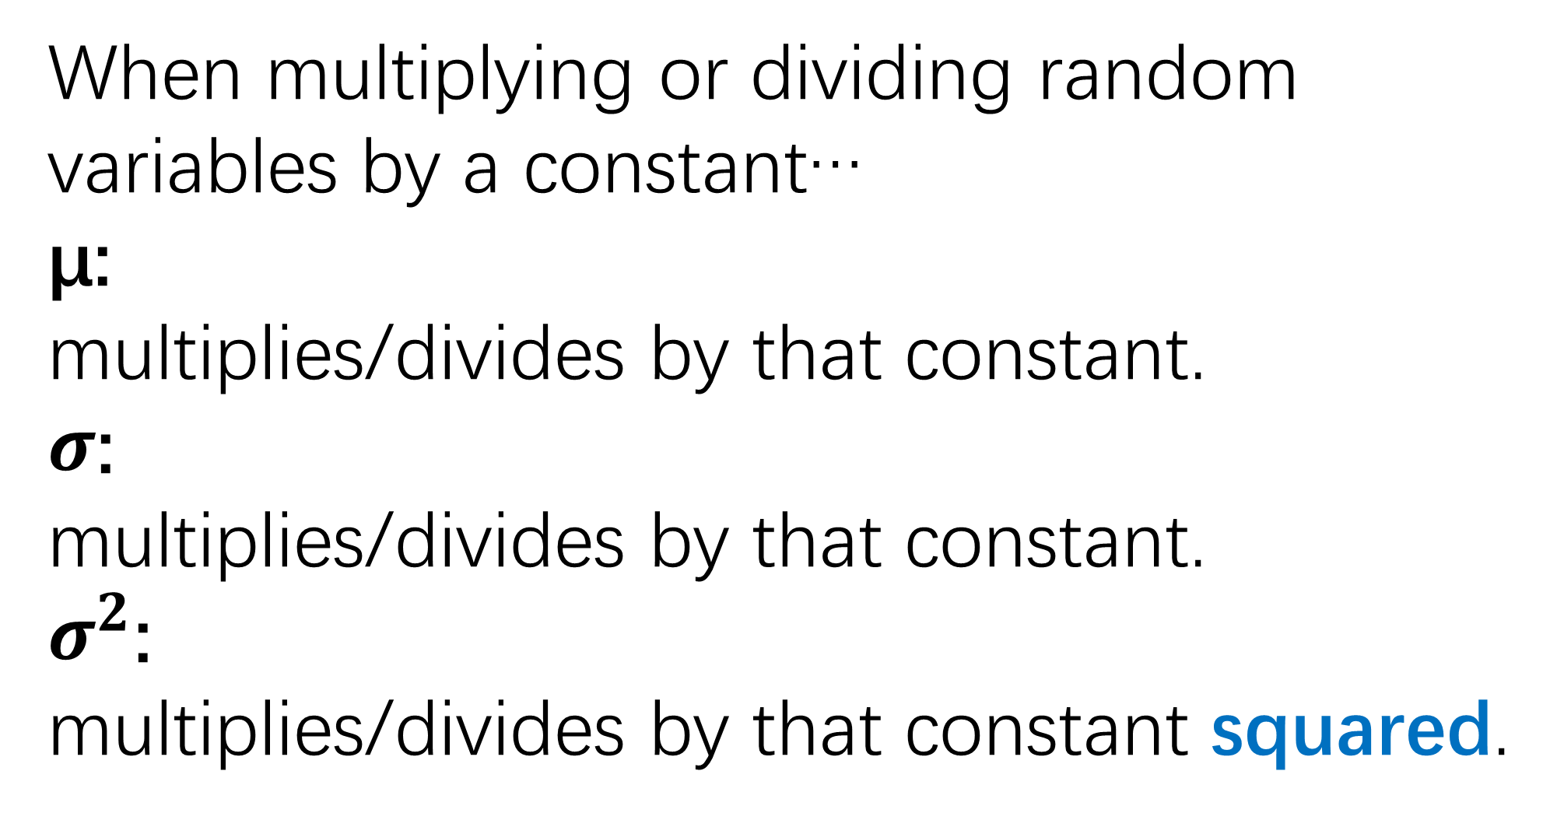
When multiplying or dividing random variables by a constant…
µ:
multiplies/divides by that constant.
$σ$:
multiplies/divides by that constant.
$σ^{2}$:
multiplies/divides by that constant squared.

Slide 18
σY=6.429
The money collected on a randomly selected ferry trip will typically vary from the mean ($19.35) by about $6.43

